Slide 1

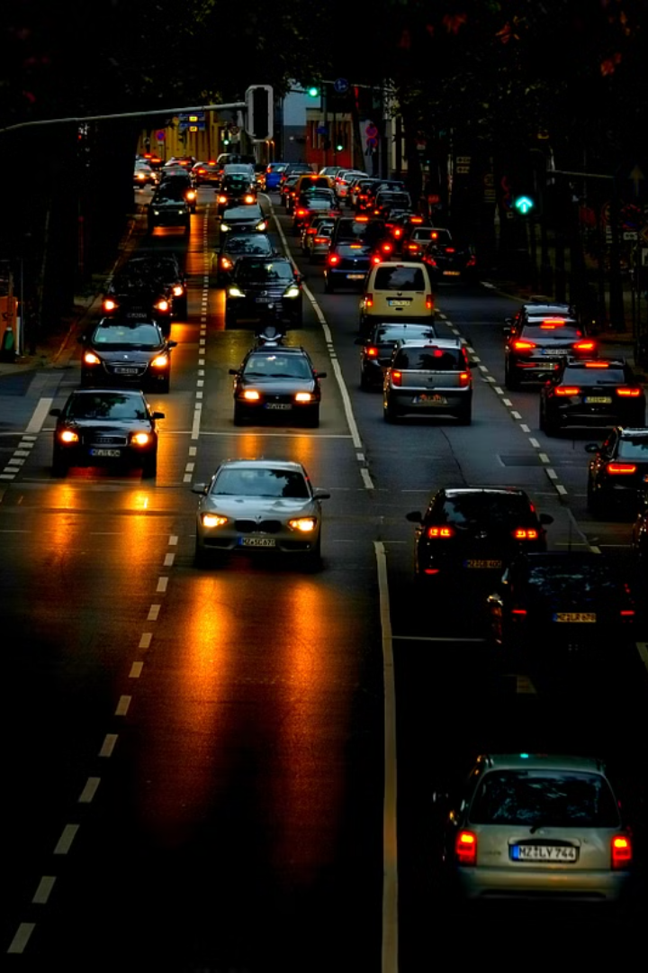

SMART TRAFFIC MANAGEMENT SYSTEM
PRESENTED BY:
Siristi Rani Paul
ID: 02
Batch: Office_Batch053

Slide 2
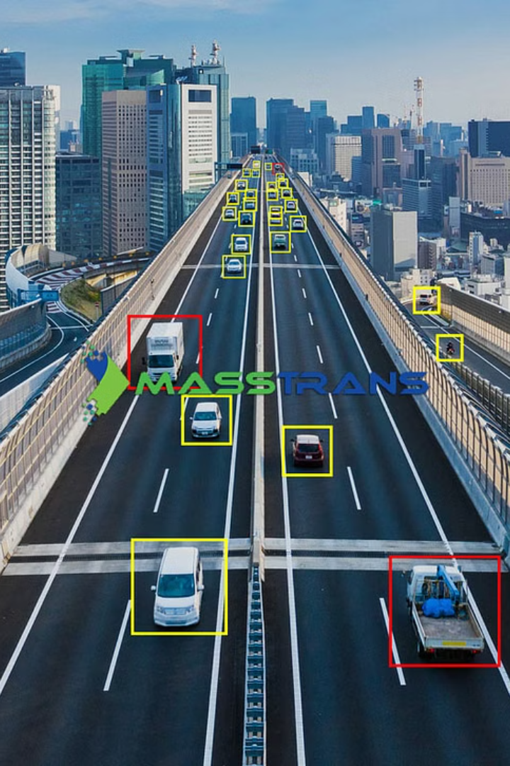
Smart Traffic Management Systems: Revolutionizing Urban Mobility
Urban traffic congestion significantly impacts productivity, the environment, and quality of life. Smart Traffic Management Systems (STMS) offer a solution by using advanced technologies to optimize traffic flow and enhance urban mobility.

Slide 3
Components of a Smart Traffic Management System
Sensor Network
Communication Network
Sensors collect real-time traffic data, including vehicle presence, speed, and direction. This data is crucial for making informed decisions about traffic flow.
The communication network transmits data between sensors, traffic controllers, and the central control center. This network ensures seamless data exchange.

Slide 4
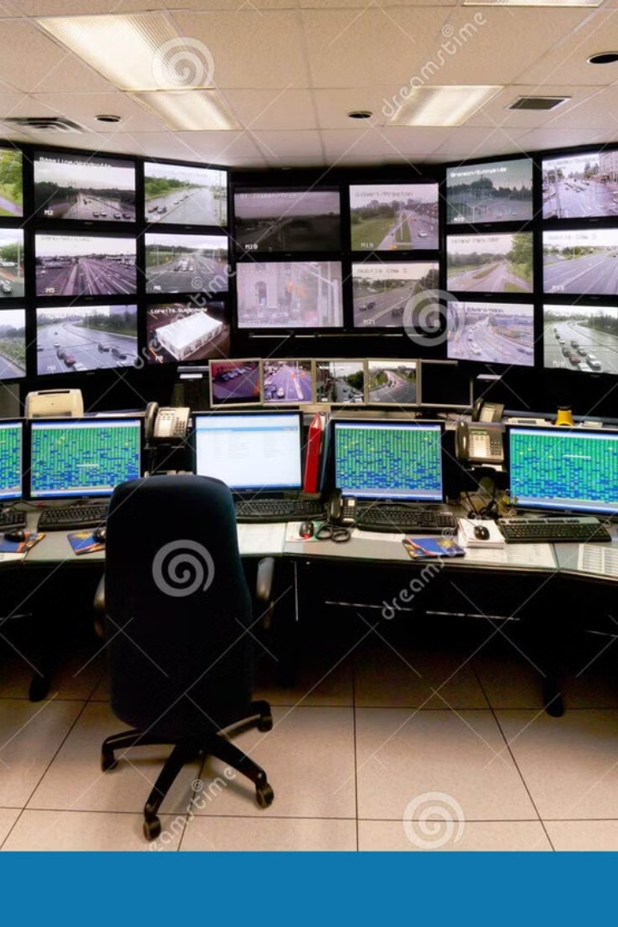
Central Control Center: The Brain of the System
1
1. Data Analysis
2
2. Traffic Management Strategies
The control center analyzes traffic data to identify patterns, congestion points, and potential issues.
Based on data analysis, the control center implements real-time traffic management strategies like adaptive signal control and dynamic lane allocation.
3
3. Incident Management
The control center responds to traffic incidents, like accidents or road closures, by adjusting traffic signals and rerouting traffic.

Slide 5
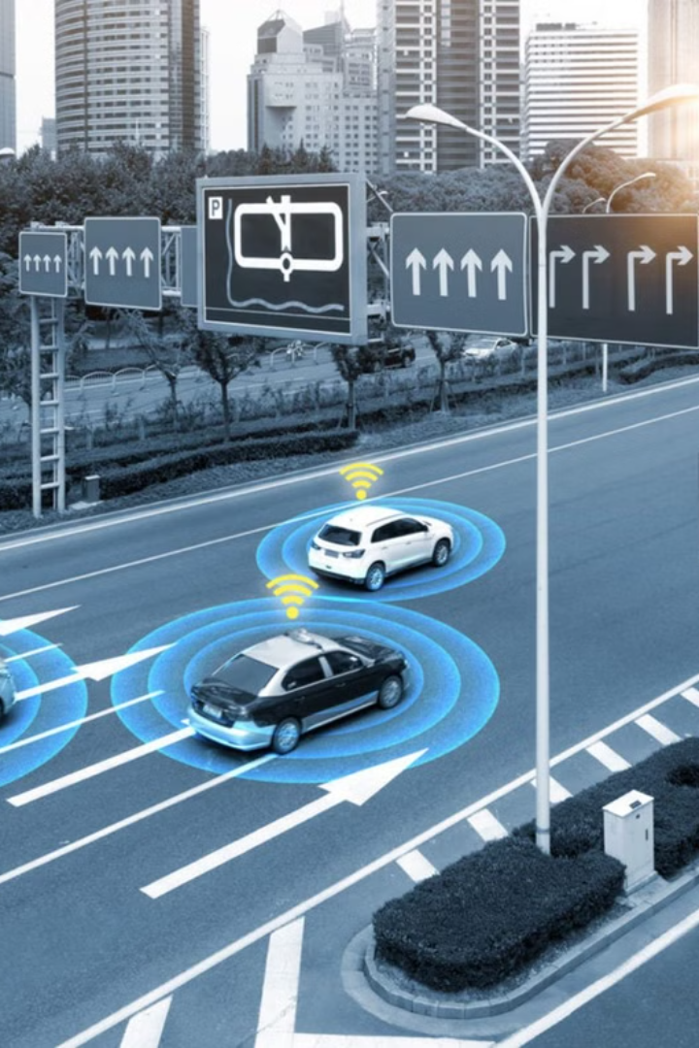


Vehicle-to-Infrastructure Communication: Connecting Vehicles and Infrastructure
Real-time Traffic Info
Cooperative Vehicle Control
V2I communication enables vehicles to receive real-time information about traffic conditions and alternative routes through in-vehicle displays or mobile apps.
V2I allows vehicles to coordinate with traffic infrastructure to improve traffic flow and safety, promoting smoother traffic flow.

Slide 6

Benefits of Smart Traffic Management Systems
Reduced Congestion
Improved Air Quality
STMS can significantly reduce traffic congestion by optimizing traffic flow, adaptive signal control, and intelligent routing.
STMS can help reduce vehicle emissions and improve air quality by minimizing idling time and traffic congestion.
Enhanced Road Safety
By detecting and responding to accidents promptly, STMS can reduce the risk of accidents and injuries.

Slide 7




Challenges and Future Directions
1
Data Privacy and Security
2
Interoperability
3
Public Acceptance
4
Emerging Technologies

Slide 8



Successful STMS Implementations Around the World
Singapore
London
Portland, Oregon
Singapore has a world-class STMS that utilizes advanced technologies, sensors, cameras, and communication technologies for efficient traffic management.
London's congestion charge zone and low emission zone have successfully reduced congestion and improved air quality.
Portland has implemented a comprehensive STMS including adaptive traffic signal control, real-time traffic information, and incident management.

Slide 9

Conclusion: Towards Smarter and Sustainable Cities
STMS offer a promising solution to address urban traffic congestion. By leveraging advanced technologies and data-driven insights, STMS can create more efficient, sustainable, and livable cities. As technology evolves, we can expect even more innovative and sophisticated STMS that will further enhance urban mobility.

